Slide 1

CYBV 480 Cyber Warfare
Week 2
Cyber Operations Overview
Mission Planning & Cyber Law

Slide 2
Agenda
Identify and describe the phases of offensive cyber operations, what each phase entails, and how operations are assessed after completion
Military Decision Making Process (MDMP)
Target Identification
Cyber Reconnaissance
Fingerprinting / Target Enumeration
Development of Operational Plans
Mission Execution
Mission Assessment
Describe the decision authorities & authorizations associated with Cyber Operations
Constitutional Authorities
President of the United States & Secretary of Defense
Executive Orders & Operations Orders
Titles 6, 10, 18, 32, 40, 44, 47, 50
Executive Order 12333

Slide 3
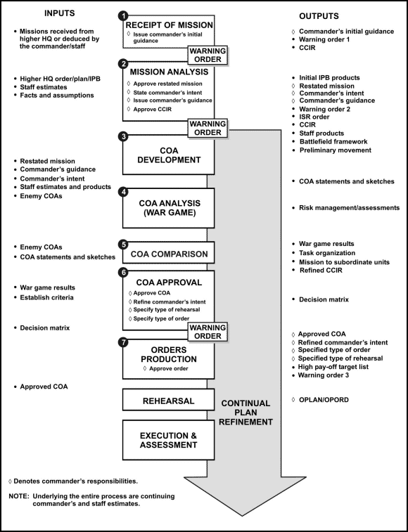
MDMP

Slide 4

MDMP
JOPES
Strategic
MDMP
Operational
TLP
Tactical

Slide 5
MDMP
Receipt of the Mission
Mission Analysis
Course of Action Development
COA Analysis
COA Comparison
COA Approval
Orders Production

Slide 6
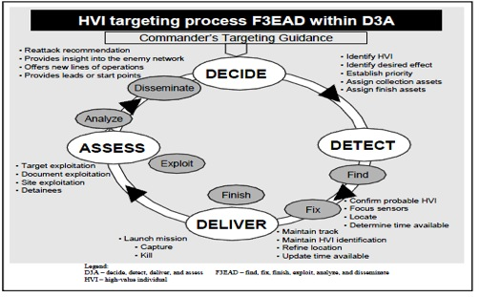
Military Targeting
Targeting is the process of selecting and prioritizing targets and matching the appropriate response to them, considering operational requirements and capabilities
A continuous cycle that ends only once you defeat the enemy or accomplish your desired end state

Slide 7
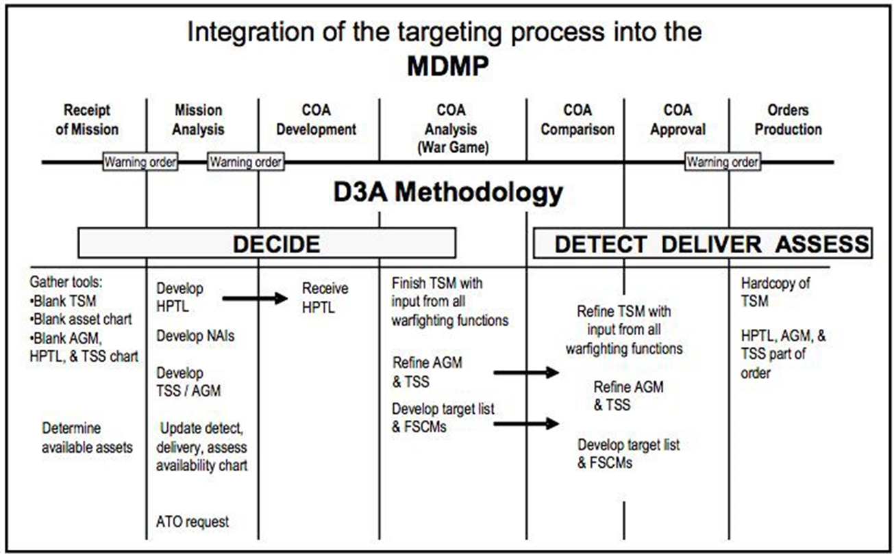
Military Targeting
How targeting and MDMP work together

Slide 8
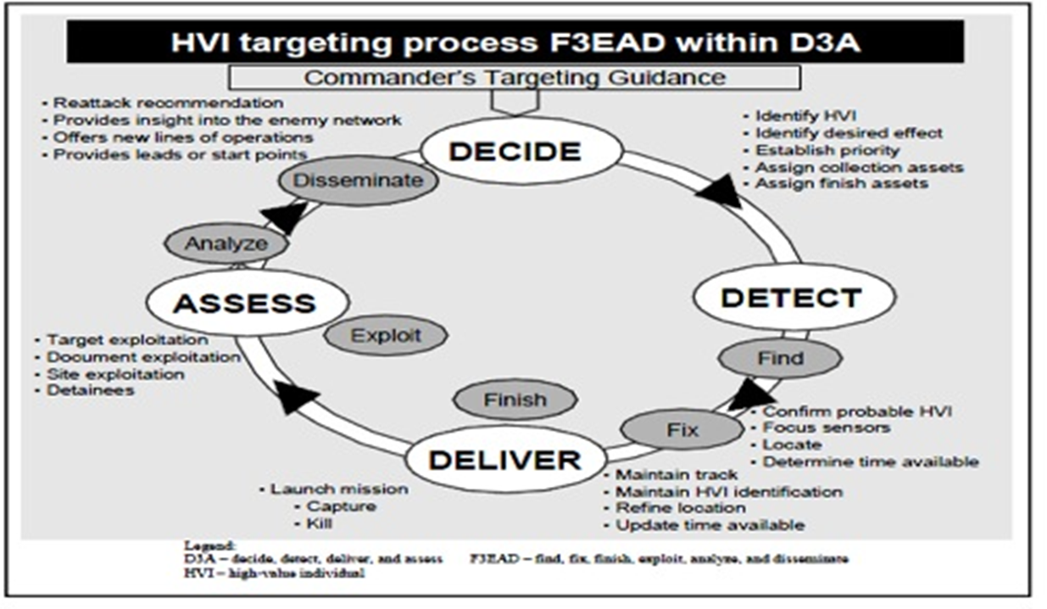
The Continuous Cycle
The battlefield is dynamic
Can never fully account for all variables
Diving further into the targeting process may:
Present new targets of opportunity
New Questions
New vulnerabilities to exploit

Slide 9
Military Targeting (Decide)
First phase of targeting
Most time intensive
Begins with Target Value Analysis
“Drawing Board”
Enemy Doctrine
Tactics
Network Topology
Equipment / Resources
Organizational Hierarchy

Slide 10
Military Targeting (Decide)
Network Topology
Equipment / Resources
How Warfighting Functions Support
Intelligence
Network Monitoring Tools
Sustainment
Supporting Hardware
Command and Control
System Administrators
Protection
IDS / IPS

Slide 11
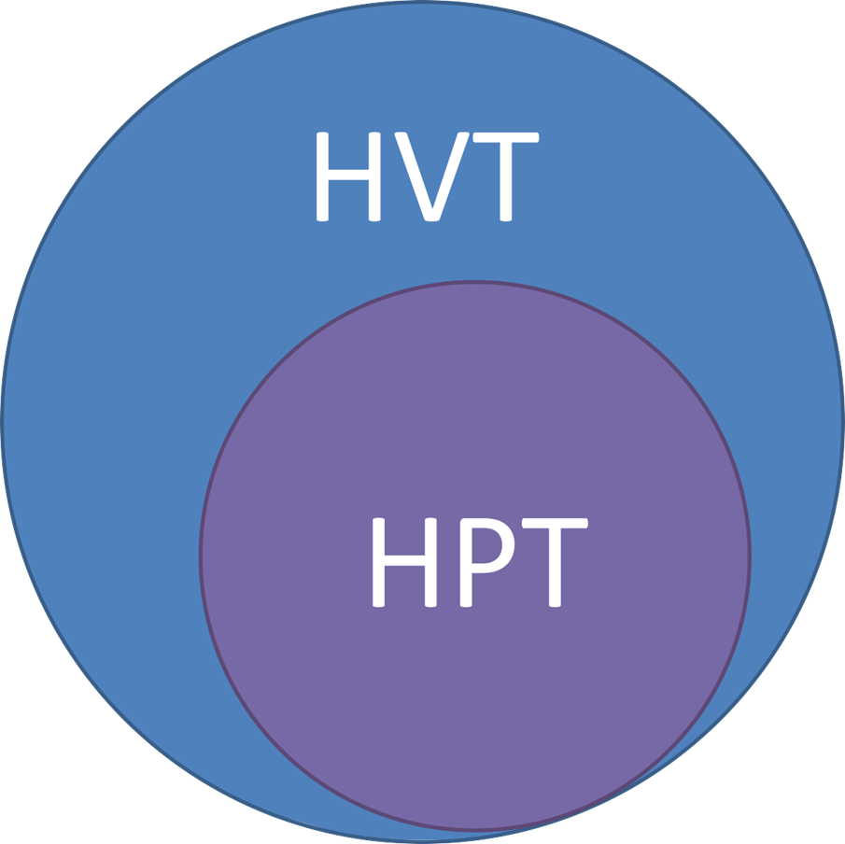
Military Targeting (Decide)
What does the enemy need for success?
High Value Target
What do I need to affect for my success?
High Payoff Target

Slide 12



Military Targeting (Decide)
High Payoff Target List prioritizes list of HPTs
Based off current intelligence and analysis
Priorities are assigned based on network topology and access control

Slide 13

Military Targeting (Decide)
Fingerprinting
Implementation of standards
Open Port
Response Times
Response to malformed data
MAC Address
sudo nmap –O localhost
https://www.sans.org/reading-room/whitepapers/authentication/os-application-fingerprinting-techniques-32923

Slide 14











Attack Guidance Matrix
Addresses
When to attack
Which assets to attack with
PACE Plan
Focus on silence, precision, and anonymity or not
HPTL WHEN HOW EFFECT REMARKS

Slide 15
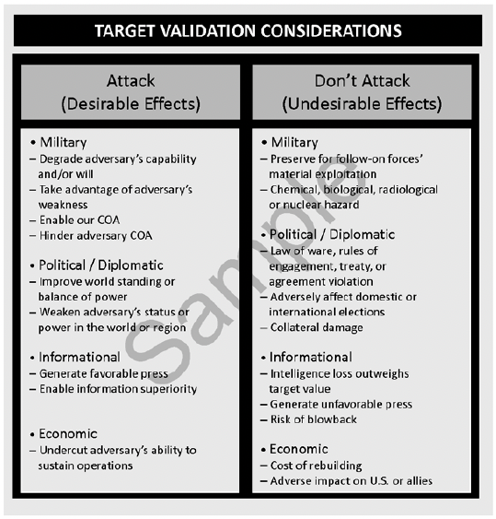
Detect
Implement Intel Collection Plan
Target Availability
Priority Level
Detection Asset
Availability
All information feeds back into “Decide”

Slide 16
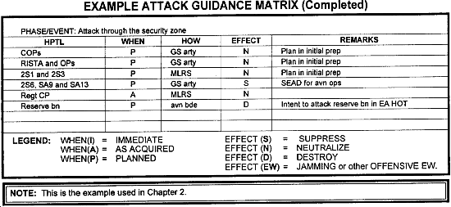
Deliver
“Rounds on target” phase
Intel gathering and analysis produces clear operating picture
Enact Attack Guidance Matrix (AGM)

Slide 17
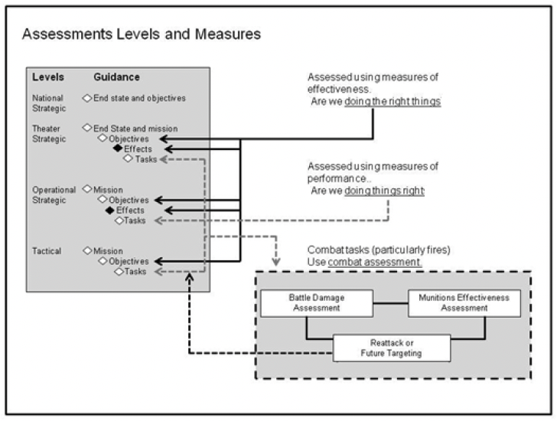
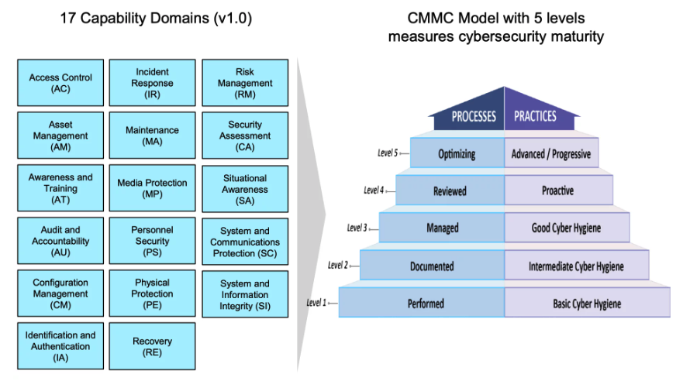
Assess
Determine qualitative assessment of exploit delivery
Measure of Performance
Measure of Effectiveness
Determine need to re-engage or move forward to the next target
All information feeds back into “Decide”
Update HPTL, ICP, or AGM as needed

Slide 18
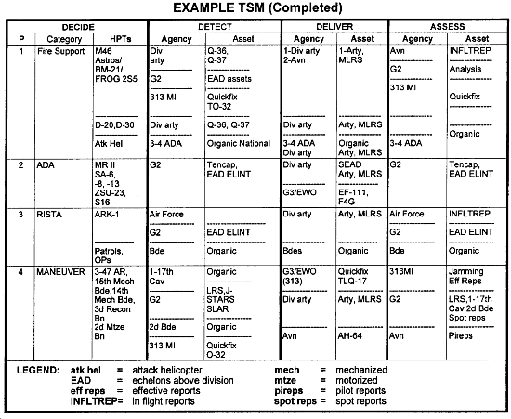
Target Sync Matrix

Slide 19

Constitutional Authorities
Constitutional power to decide whether to go to war lies with congress
(Un?) Constitutional Authorities
Presidential Authority for the use of Military Force (AUMF)
Role of the DoD and IC
CNE != OCO

Slide 20
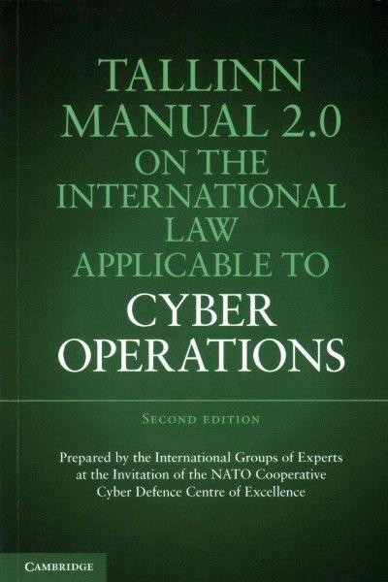
Cyber Law & Policy
No established international norms or International Cyber Laws (ICL)
Tallinn Manual 2.0 is next best thing

Slide 21
Cyber Law & Policy (U.S Code 1 of 3)
Title 6 – Domestic Security
Homeland Security
Cyber authorities, info sharing, public-private partnerships
Title 40 – Public Building, Properties, and Work
Critical Infrastructure and Key Resources (CIKR)
IT Management and Procurement
Title 44 – Public Printing & Documents
Federal Data Management & Access
Title 47 – Telecommunications
Undersea Cables
EM Spectrum Management
Digital Communications Intercept

Slide 22
Cyber Law & Policy (U.S Code 2 of 3)
Title 10 – Armed Forces
The Secretary of Defense shall develop, prepare, and coordinate; make ready all armed forces for purposes of; and, when appropriately authorized to do so, conduct a military cyber operation in response to malicious cyber activity carried out against the United Sates or a United States person by a foreign power
Title 50 – War and National Defense
NSA and USCC use Title 50
USCC was created for Title 10 operations
Under Title 50, a “covert action: is subject to presidential finding and Intelligence Committee notification requirements. Traditional military activity, although undefined, is an explicit exception to the Title 50 U.S.C. covert action definition in Section 913 as the identity of the sponsor of a traditional military activity may be well known

Slide 23
Cyber Law & Policy (U.S Code 3 of 3)
Title 32 – National Guard
National Guard cyberspace forces fall under Title 10 / 50 authority (situation dependent) when operating under federal orders
Title 18 – Crimes and Criminal Procedure
Law Enforcement (FBI)
2011 – 2012 NDAA Section 954 – Armed Conflict and Clandestine Operations
Department of Defense has the authority upon direction of the President to conduct offensive cyber operations to defend our Nation, Allies and Interests subject to:
The policy, principles, and legal regimes that the Department follows for kinetic capabilities, including the law of armed conflict…
The War Powers Resolution (Title 50, Section 1541)

Slide 24


Covert vs Clandestine
Covert – someone did it, we don’t know who
Clandestine – no one knows it happened

Slide 25

Cyber Law & Policy Executive Order
Executive Order 12333
Process for intelligence requests within Intelligence Community (IC)
Basis for data collection activities

Slide 26
Cyber Law & Policy Presidential Policy Directives
Presidential Policy Directive 20 (PPD-20)
Classified document
As specifically described in the White House fact sheet, PPD-20:
Takes into account the evolution of the threat and growing experience with the threat
Establishes principles and processes for using cyber operations so cyber tools are integrated with the full array of national security tools
Provides a whole-of-government approach consistent with values promoted domestically and internationally and articulated in the International Strategy for Cyberspace
Mandates that the United States take the least action necessary to mitigate threats
Prioritizes network defense and law enforcement as preferred courses of action

Slide 27
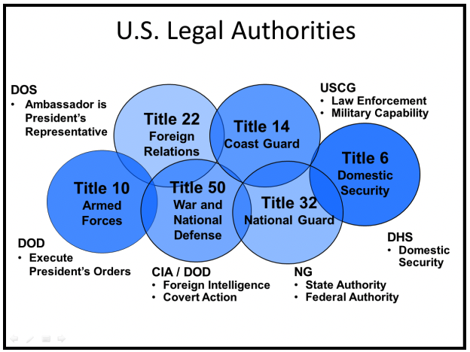
Cyber Law & Policy (U.S Code 3 of 3)

Slide 28
Questions?
Coming Next Week
Reconnaissance

